Slide 1
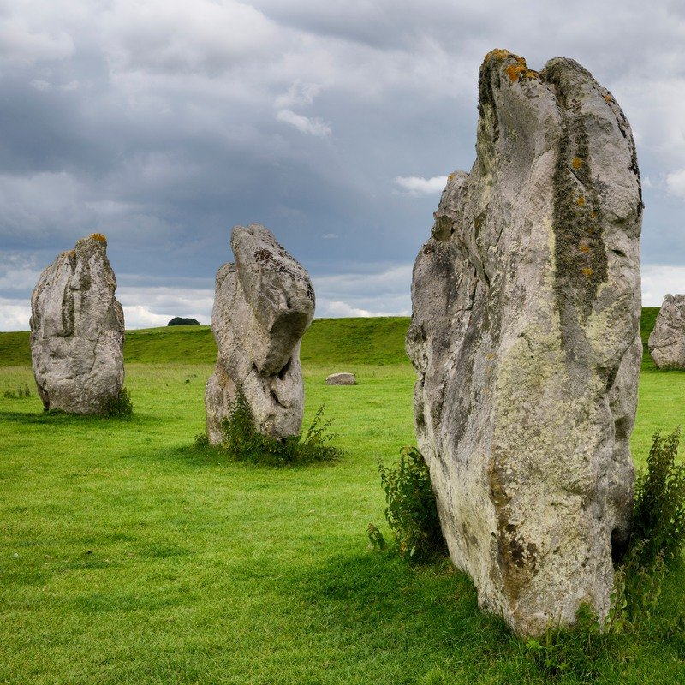
Avebury Stone Circle
We think Avebury was built when the Stone
Age people were around. It was built in the
Neolithic time period.
Noah and Gabriella

Slide 2
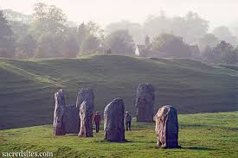
The largest stone in Avebury weighs about 100 tones.
Avebury wasn’t built all at once.
Avebury used to have 100 stones, now it only has 30 stones.

Slide 3
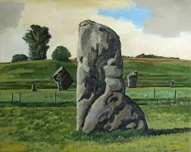
We think the stones arrived by…
The logs were beneath the stones and they pushed it.
The Stone Age people probably walked and carried the stones.

Slide 4
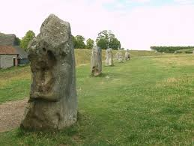
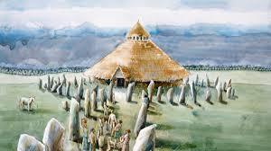
This compares the stones at Avebury from now to the stones at Avebury when it was Stone Age time.
Now
Then

